Slide 1
C Arrays and Pointers
Fresher Learning Program
January, 2012
Notes:
© 2006 Capgemini - All rights reserved

Slide 2
Pointers
Multiple variables can point to the same address in computer memory.
Pointer: A variable containing the address of another variable.
The operator * is used to precede the name of the pointer variable
int *Array=(int *) malloc (Length * sizeof(int);
The output of malloc is of type (void *). This needs to be converted to be of type (int *) for an integer variable.
© 2011 Capgemini - All rights reserved

Slide 3
Pointers .. continued
The operator & when used with non-pointer variable returns the address of the variable.
    int Variable1 = 235; /* Allocates memory while loading the executable */
    printf("%d",Variable1);
    int *Var_ptr = &Variable1; /* Pointer Var_ptr contains the address */
    printf(“%p points to %p”, Var_ptr, &Variable1);
    /* The memory locations should be identical */
© 2011 Capgemini - All rights reserved

Slide 4
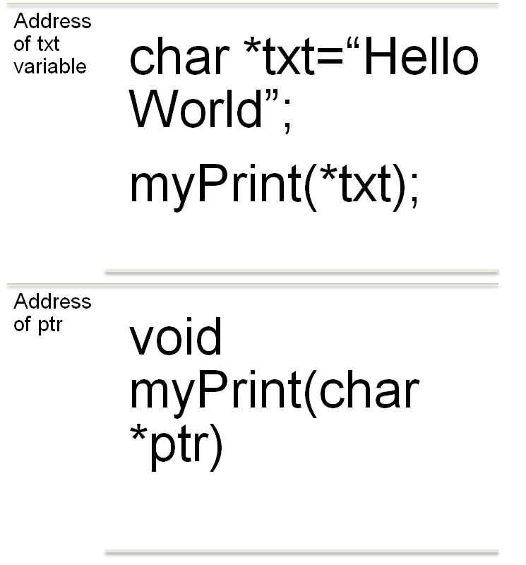
Pointers as function arguments
When used as function arguments, C allows a choice if the copy of the pointer or pointer itself is used.
  To use a copy as a string-literal as shown in the figure, pass the pointer to the function
  To modify the argument itself, use myPrint(&txt). This is useful for linked list implementation
© 2011 Capgemini - All rights reserved

Slide 5
Pointer arithmetic
Arithmetic cannot be used on void * pointers
Difference between two pointers in contiguos memory locations will give the size of the struct.
Pointers and Arrays can be used interchangeably
© 2007 Capgemini - All rights reserved

Slide 6
Thank You For Your Time
Notes:
© 2006 Capgemini - All rights reserved

